Slide 1
Analysis of Airbnb Booking Rates in New York City on 10.Dec.2020
By: TaeJoon Kim
Presented on: 4.Jan.2021

Slide 2
Overview and Purpose
Airbnb shares its listings data based on city and month: http://insideairbnb.com/
This project is based on data for NYC in December 10th, 2020.
Machine learning models were implemented to identify which airbnb listings were to have no bookings for the next 90 days.
The results in this project may be referenced by Airbnb hosts to increase their chances of booking, which ultimately leads to profit.
The results may also be used by Airbnb to identify which listings to promote and focus on.

Slide 3
Preview of Results
Machine learning models(KNN, Random Forests) were able to predict non-booked and booked listings with around 80% accuracy.
The biggest factors that determined booking rates were not necessarily features of the house itself.
Rather, large portion of the key features were based on the host information (i.e., whether the host was responsive, whether the host was superhost)

Slide 4
Data
Raw listings data contained 74 columns and 36923 rows of data
After extensive data cleaning (i.e., NaN values) and manipulation (i.e., binning), the final data contained 23 columns and 36821 rows.
After one hot encoding, column numbers came out to be 298 columns.
About 43% of the listings did not have any bookings for the next 90 days.

Slide 5
Features
The columns in this DataFrame were:
'host_response_time', 'host_response_rate', 'host_is_superhost', 'host_listings_count', 'host_has_profile_pic', 'host_identity_verified',
'neighbourhood_cleansed', 'room_type', 'accommodates', 'bathrooms_text', 'bedrooms',
'price',
'availability_90',
'number_of_reviews', 'last_review', 'review_scores_rating', 'review_scores_accuracy', 'review_scores_cleanliness', 'review_scores_checkin', 'review_scores_communication', 'review_scores_location', 'review_scores_value',
'instant_bookable'

Slide 6
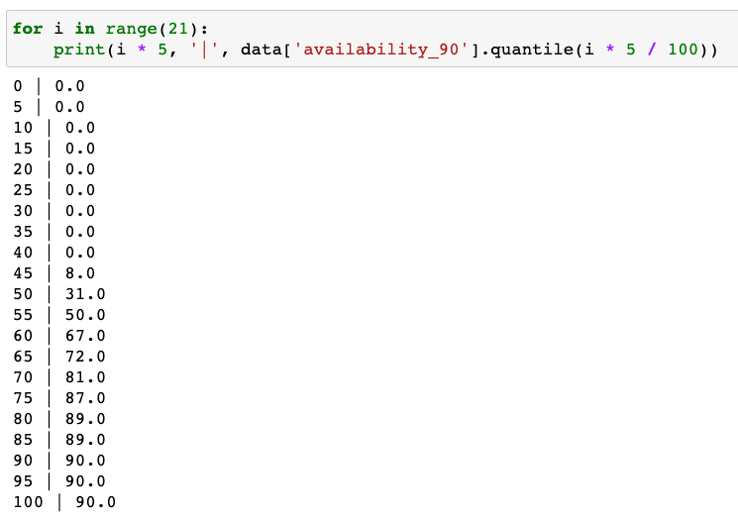
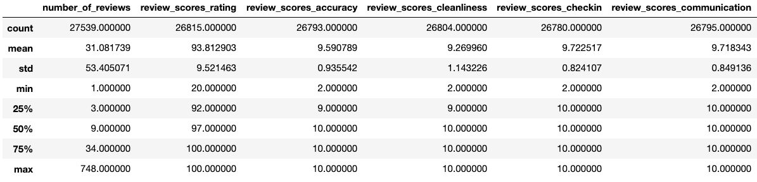
Feature Manipulation

Slide 7
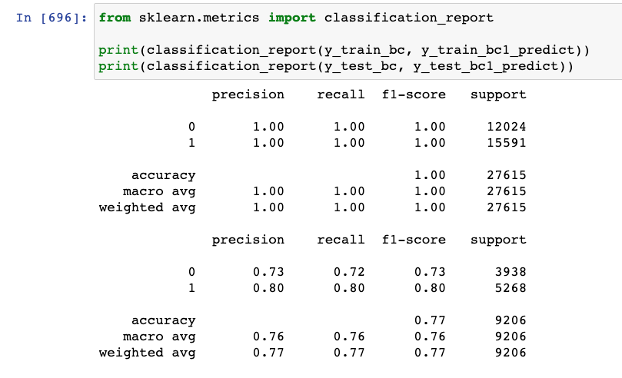
K-Nearest Neighbors
Perfect scores on the train data, and 77% for test data.
Optimal number of neighbors was 17 and optimal weight was ‘distance.’

Slide 8
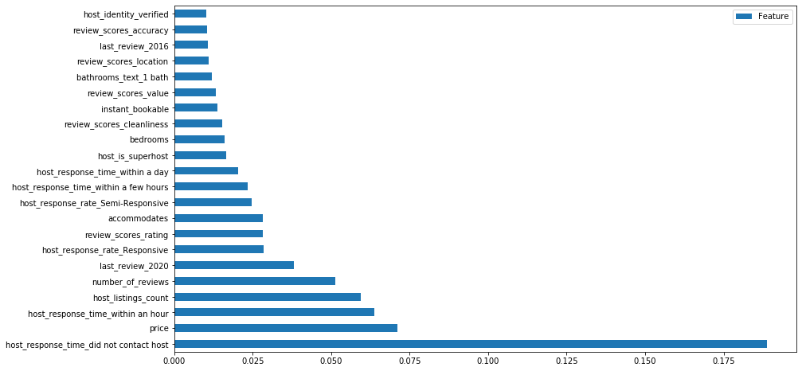
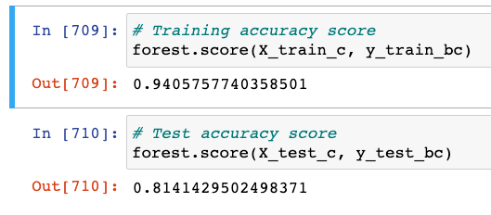
Random Forests

Slide 9
Key Findings and Recommendations
The features of the property and property location did not have a profound impact.
As for reviews, it was important that the listing had a review in 2020.
Price had the second highest impact.
Highest impact was whether the client reached out to the host or not - If there is ambiguity in the listing that require the client to contact the host.
Host response rate generally had the greatest impact - it is essential that the host responds immediately to their potential clients!

Slide 10
Future Works
Implement NLP/Naive Bayes to analyze listing information (i.e., description, title, amenities)
Improving data manipulation may improve model performance
Do further modelling with non-zero booking listings to gain more insights on which listings tend to do well.

Slide 11
Thank You!
Github repository: https://github.com/tjkim614/airbnb_nyc_dec_2020
Contact via email: tjkim614@gmail.com

